Slide 1

RealEase: Comprehensive Real Estate Insights Platform
Milestone 2 Overview
By Donovan Murphy, Jonathan Bailey, and Enrique Obregon

Slide 2
Milestone Overview
Developed front-end components
Advanced backend integration
Initiated ROI and home comparison tools
Focused on API research and testing

Slide 3
Milestone Two Plan
Task | Completion % | Donovan | Jonathan | Enrique | To Do
ROI Tool | 65% | 10% | 80% | 10% | Upscale the tool to implement APIs
Investigate JavaScript functions and card layout on home screen | 65% | 80% | 10% | 10% | Continue to improve functionality
Working Website Demos | 65% | 60% | 20% | 20% | Continue to add features to the demos
Improve on early stage demo, increase size, improve layout, and determine caching vs. API calls | 40% | 20% | 20% | 60% | Compare Flask vs MERN and plan optimal data retrieval methods for different features
Frontend Development & Card Display | 80% | 70% | 10% | 20% | Refine card layout and test user interactions
Database Schema and Backend Integration | 70% | 50% | 30% | 20% | Finalize schema adjustments based on API integration needs
API Research and Testing | 60% | 40% | 30% | 30% | Refine API list and assess functionality for seamless backend integration
Home Comparison Tool (Early Stages) | 30% | 20% | 20% | 60% | Design comparison criteria and data inputs for enhanced user experience
Front End Layout, Logo, and Color Scheme | 90% | 70% | 15% | 15% | Logo is complete; continue accent color research for improved visual appeal
Testing | 80% | 30% | 20% | 50% | Develop further test cases as more features progress through implementation

Slide 4
Task 1: Frontend Development and Card Display
Developed dynamic property cards for user interaction on the home screen.
Improved user interface for better engagement.

Slide 5
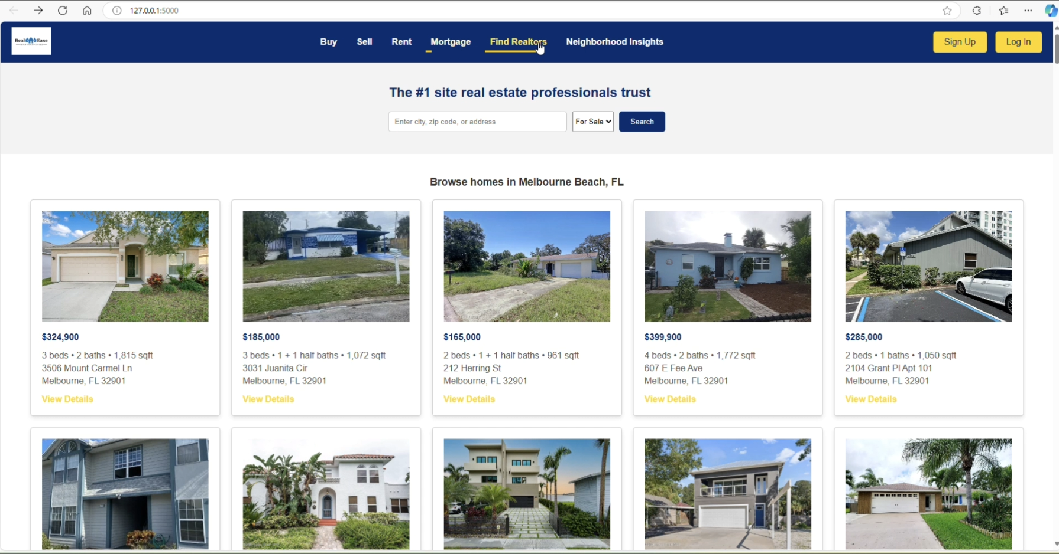
Task 1 Continued:
Continued development of the front-end in React, focusing on displaying results from user searches, including Neighborhood Insights, property listings, home comparison, and ROI calculations.

Slide 6
Task 2: Database Schema & Backend Integration
Created and integrated a MongoDB-based schema to support data storage.
Laid groundwork for seamless front-end and back-end communication.

Slide 7


Task 3: Flask Integration Exploration
Developed strategies to leverage Python with MERN stack for future features.
Researched Flask integration to enhance ROI tool functionality.

Slide 8
Task 4: API Research & Testing
Compared Express and Flask for backend operations.
Established groundwork for API-driven data management

Slide 9
Milestone Three Plan
Task | Donovan | Jonathan | Enrique
1. Continue to research and test out caching vs python scrapping, and investigate scheduled API calls | implement/test 40% | Research 20% | Demo 40%
2. Planning and begin development of home comparison tool and ROI calculator | Design 30% | Design 30% | Design 40%
3. Look into the exact data we want to use for the open search vs. Neighborhood insights dashboard | Implementation and test 20% | Research and early testing 50% | Test 30%
4. Refining API List and Continued Testing of current product | Refine and test 70% |  | Test and Demo 30%

Slide 10
Task 1: Caching vs. Python Scraping & Scheduled API Calls
The team will finalize the MongoDB schema, ensuring it handles property, neighborhood, and user data effectively.
We'll investigate caching mechanisms to optimize frequently accessed data and explore scheduled API calls to keep the platform updated with the latest data.

Slide 11
Task 2: Home Comparison Tool & ROI Calculator Development
Begin integrating data from the APIs into key features like the Neighborhood Insights Dashboard, Home Comparison Tool, and ROI Calculator.
Plan how data will be displayed and queried for each feature to ensure seamless functionality.

Slide 12
Task 3: Data Selection for Open Search & Insights Dashboard
We will continue testing the APIs, focusing on error handling and ensuring smooth data retrieval.
The team will refine fallback strategies for instances where APIs return incomplete or slow data.

Slide 13
Faculty Advisor Feedback
Guidance on Data Retrieval Planning
Emphasis on unified data pull strategies to maintain performance.
Demo Development:
Iterative improvement based on client feedback to enhance user experience.
Front-End Design Recommendations
Focus on cohesive brand identity with SVG logo integration.

Slide 14
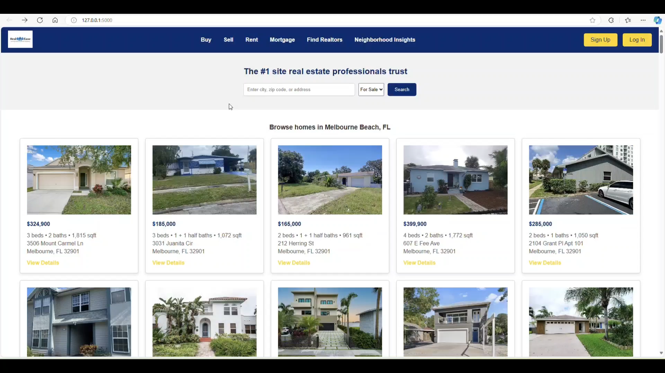
Main Menu Search Demo

Slide 15

Questions?

